Slide 1
Lombok Introduction and Eclipse Installation
Lombok is very handy tool for minimizing the boilerplate code as well as providing lot’s of other features such as lazy loading, thread safety or immutability. This is the reason it becoming very popular among the developer community.
Lombok is a open source library (basically a standalone jar) which is capable of doing magic in automating the boilerplate code generation for any java class. So if Lombok is in classpath, it can easily get rid of all the getters & setters methods, class constructors, hashcode and equals methods and many more by just adding couple of annotations the class.

Slide 2
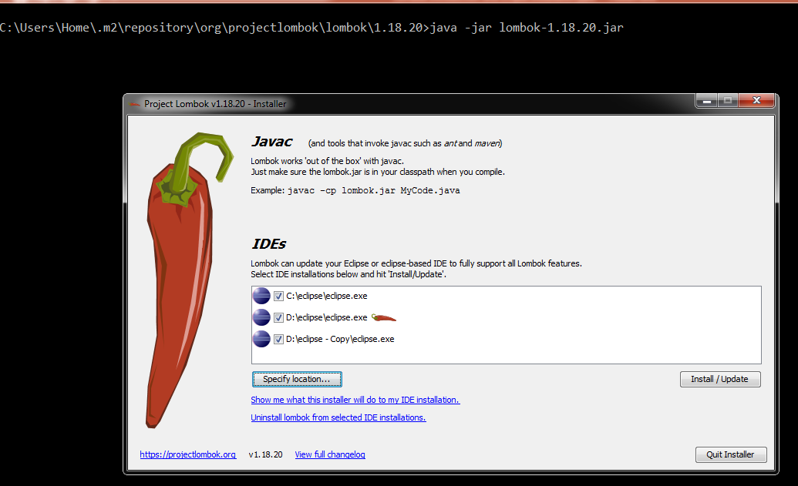
Lombok Introduction and Eclipse Installation
java -jar lombok-1.18.20.jar

Slide 3
Lombok Introduction and Eclipse Installation
We all have to generate this java bean pattern heavily in day to day work and it has become so popular that all the IDEs have given feature to generate the Getters and Setters – but once generated by IDE, the issue is we need to carry those code in whole lifetime of the project and we need to maintain those and it also increases the line of code of the whole project. With Lombok, we need to add few annotations in the class and we are done. To generate Setters and Getters we need to just add @Getter and @Setter at the class level.
Lombok can easily generate the constructors, both no arguments and with fields. We need to add annotation @NoArgsConstructor to generate the implicit no-argument constructor and @RequiredArgsConstructor to add required field constructor.
Also, to make a field required, we need to add @NonNull in the field
We can easily add default implementation of these methods by adding annotations @ToString and @EqualsAndHashCode in the class level.
We can easily add builder pattern in our code using Lombok. We don’t have to write separate builder class. Lombok will generate the builder along with fluent setter-like methods by simply adding the @Builder annotation in the class level

Slide 4
Lombok Introduction and Eclipse Installation
We have few more annotations, which are also very useful as well. Those are left for you to try and play with. e.g.
@Data
@Delegate
@Synchronized
@Slf4j
@Cleanup

Slide 5
Lombok Introduction and Eclipse Installation
Delomboking – Rollback Lombok from Project
Think about this scenario where you had decided to take advantage of Lombok and already added lots of annotations and suddenly due to some change in the decision-makers in the project, you have been asked to stop using Lombok and need to go with the old way of doing things.
Now it would not be a easy task at all to revert all the annotations that has been added with the boilerplate code. To do that Lombok itself has provided some steps, by which we can easily replace the annotated source code by the Lombok generated classes.
java -jar lombok-1.18.20.jar delombok src -d src-delomboked

